Slide 1

Design Your Code(DYC) -Designer Helper
Project Proposal

Slide 2


About Team & Role
Project Motivation
Project Goal & Details
Project Development – Language & Platform
Difference with other Program
Project Schedule
Other Ideas
content

Slide 3
About Team & Role
Team Member & Roles
20155604 구동완 - Back-end Development
20186738 김민지 – Front-end Development
20151012 최현준 – Content Development
Team o8o

Slide 4
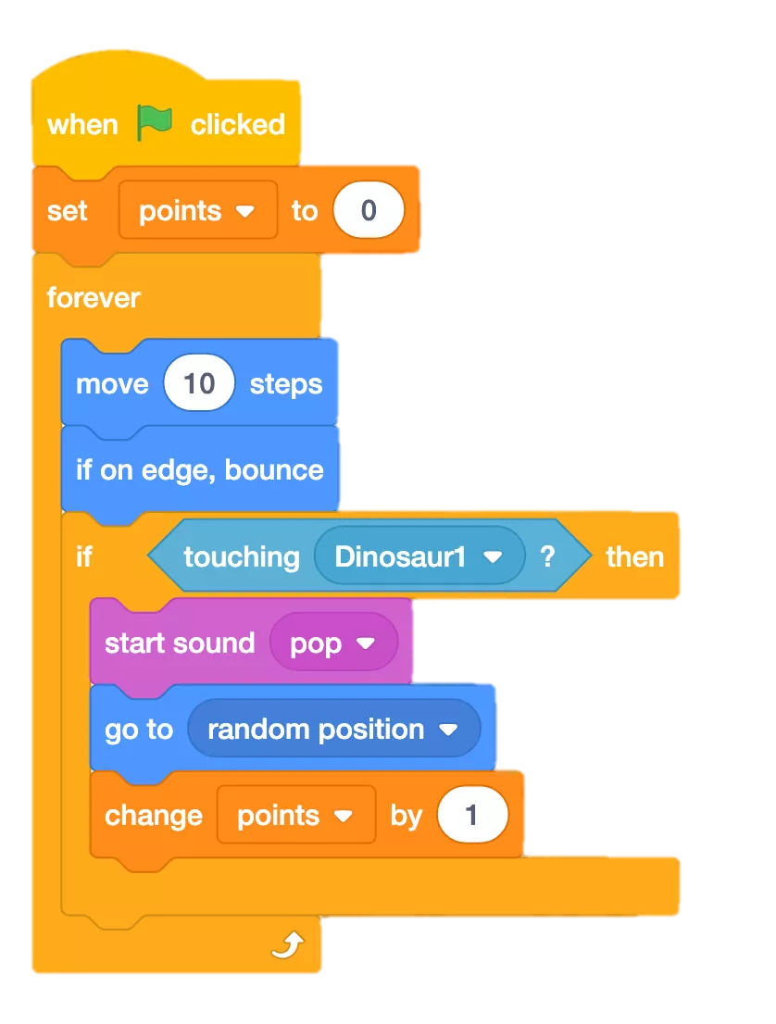
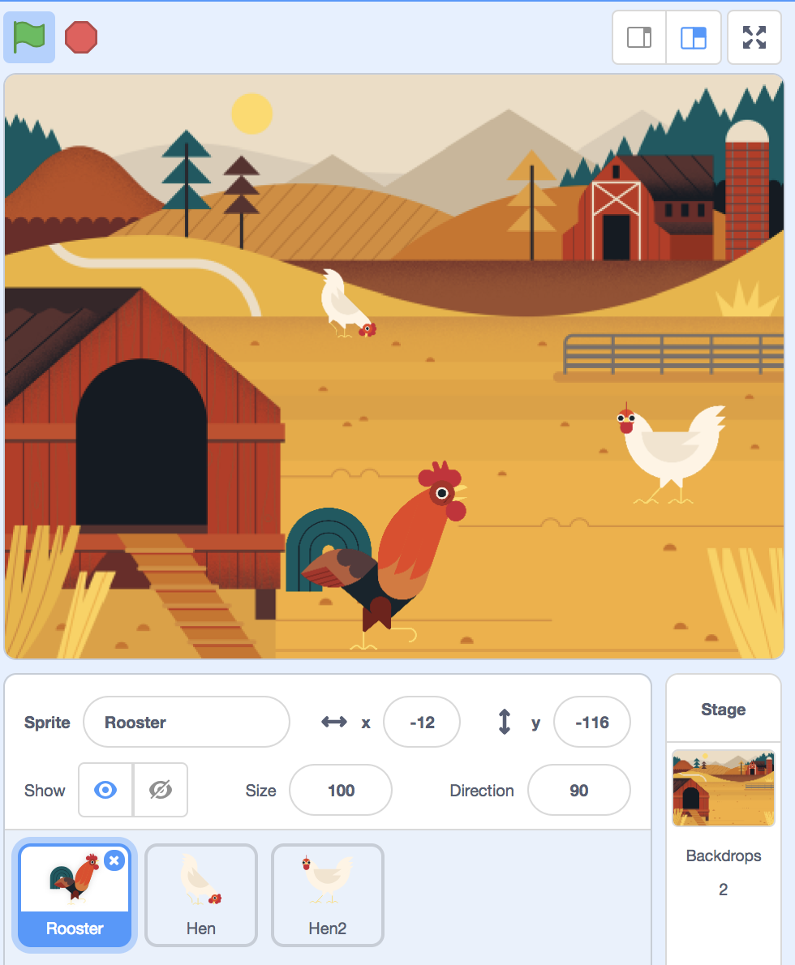

2. Project Motivation
Many people are having a hard time learning a new computer language.
< Example of Scratch >

Slide 5

2. Project Motivation
Many people are having a hard time learning a new computer language.
We designed a project that relieves the burden by using block coding
< Example of Scratch >

Slide 6


3. Project Goal
Lowering Entry Barriers
for Computer Language Beginners

Slide 7


3. Details
- Code Conversion (Block to Python)
- SNS (Information Sharing and Q&A)
- Code Conversion (UI to React)

Slide 8


3. Details
Code Conversion (UI to React)
With “ DYC ” !

Slide 9




4. Project Development – Language & Platform

Slide 10
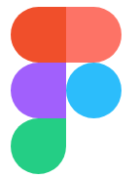


5. Difference with other Program
Figma

Slide 11
6. Project Schedule
week | Development Schedule
1 | Idea planning and preparation for presentation
2 | Determining the project content and Distributing detail roles - 1
3 | Language study and Distributing detail roles - 2
4 | 최현준 Block coding Content Development | 김민지 Front-end /SNS Development | 구동완 Back –end /SNS Development
5
6
7
8 | Functional Integration and Bug fixing Second demo preparation
9 | Functional Integration and Bug fixing
10 | Development of additional React functions
11 | Development of additional React functions
12 | Development of additional React functions
13 | Functional Integration and Bug fixing Final Demo preparation
14 | Final Demo

Slide 12

7. Other Ideas
Other Ideas for “ DYC ”
Allows users to specify the color and appearance of code blocks
Support for other languages besides Python
Autocomplete function

Slide 13

7. Other Ideas
VR AR Studio: A app that helps designers and developers cooperate when using 3D designs such as AR and VR
AR 같이 사진 찍자: These days, it's hard to go outside. So you can combine your pictures using cell phone and make it feel like you're on a trip.
방 사진 인테리어 평가: When you upload a picture of the room, it recognizes the layout of the furniture and scores it. It also recommends colors and interior tips that go well with it.
운동 코스 추천: Based on location data, this app recommends exercise courses that are suitable for users.
자취생 공동구매: Based on location data, this app helps residents to purchase essentials (such as water, shampoo… ) together.
Other
Project
Ideas

Slide 14
Thank you

